Slide 1
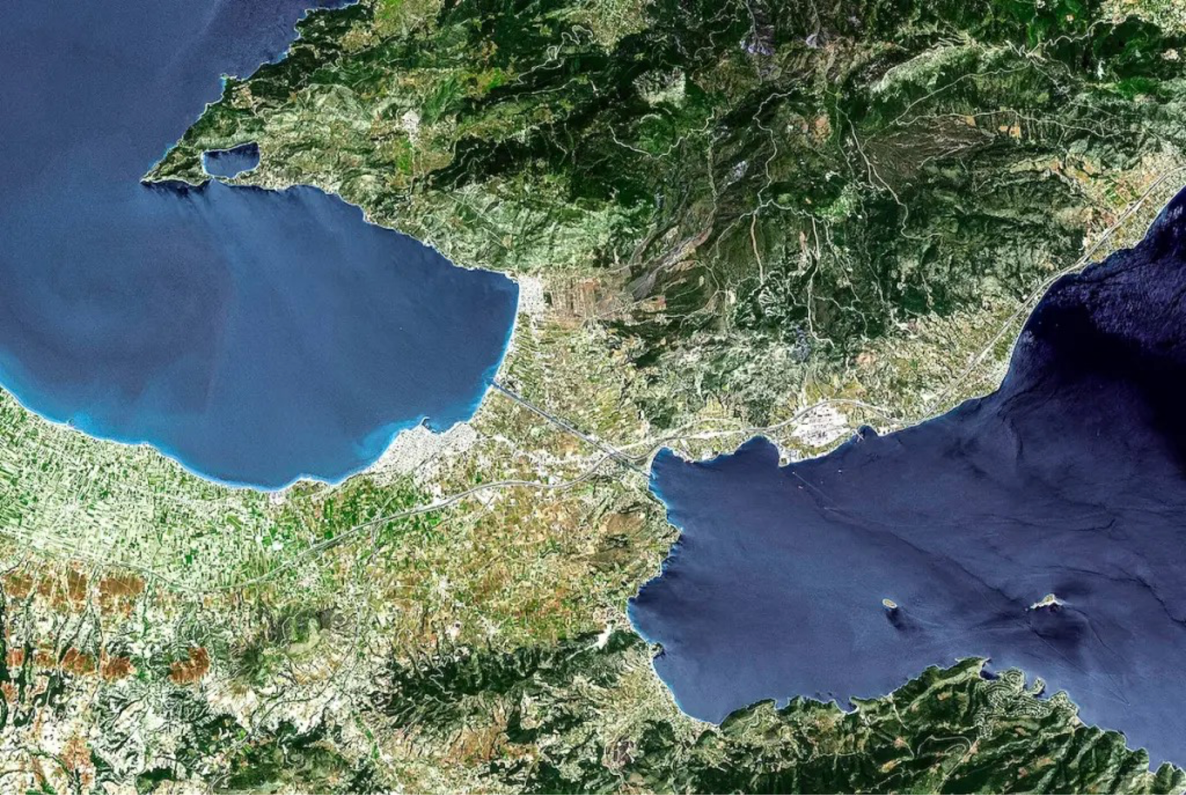

Troubles in Corinth
An urgent message to the Corinthian Church of Christ

Slide 2
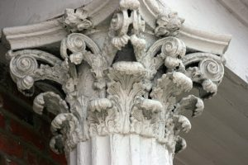
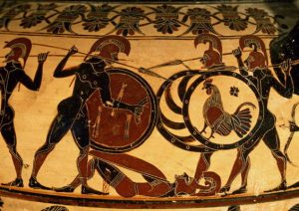
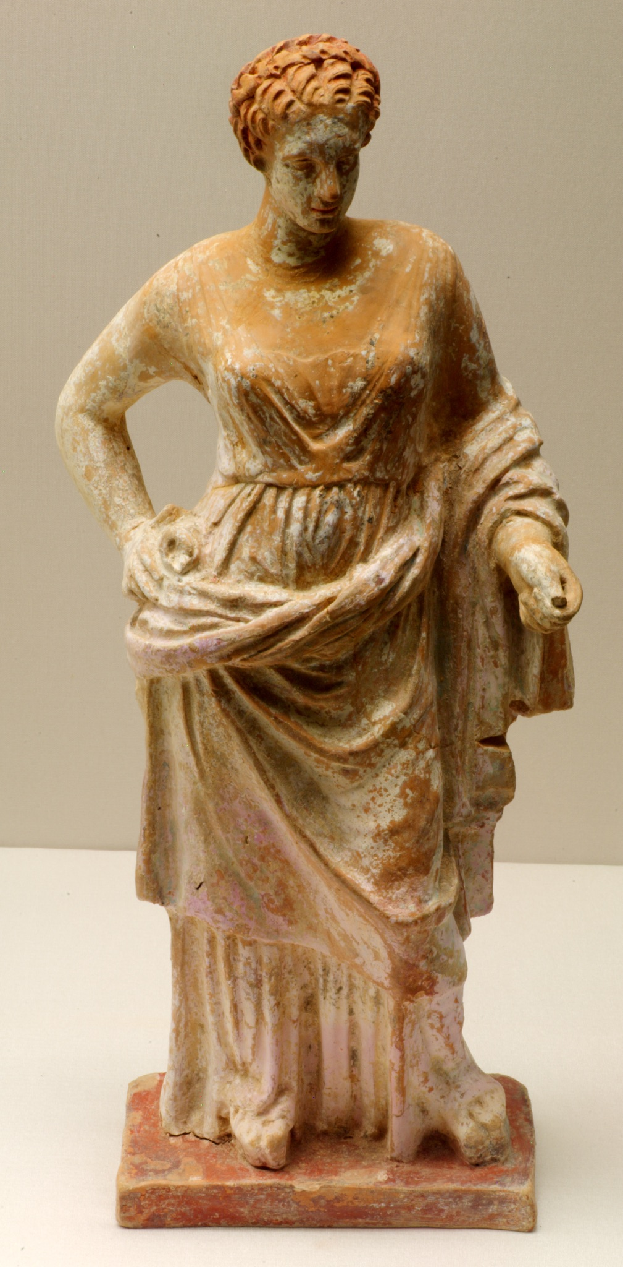
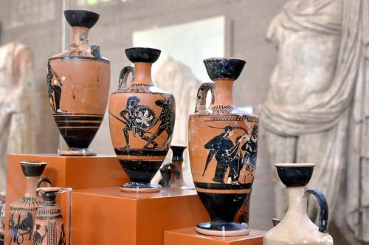
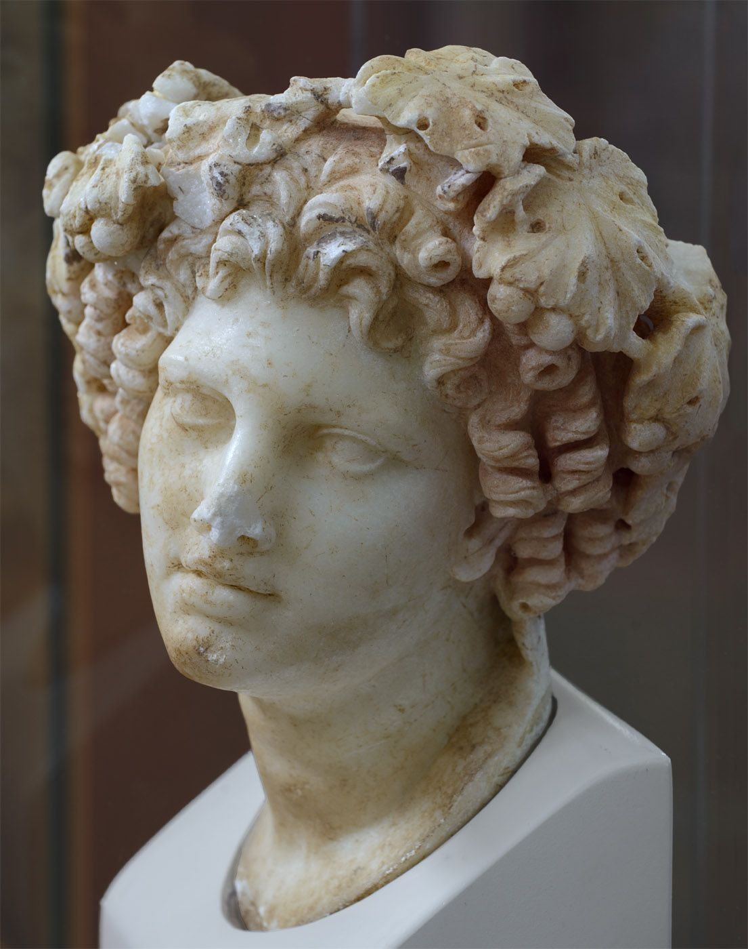
Troubles in Corinth

Slide 3
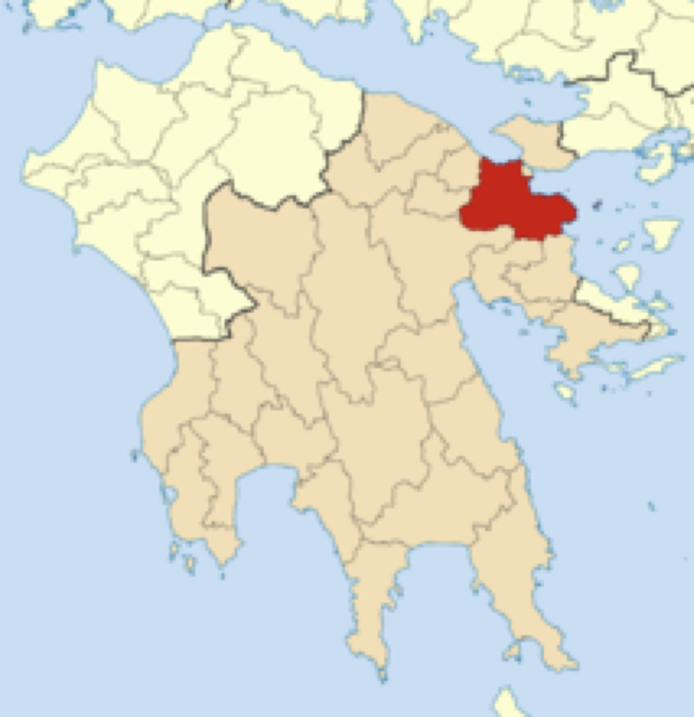
Troubles in Corinth
Overview of Leicester in 2023, so far:
Learning about the biblical nature of the Christian church
Studying out the parables of Jesus in the New Testament
Developing our skills to help people become Christians (mid-week meetings)
1 Corinthians - studying the apostle Paul’s fatherly letter to help unify a young, fractious first century church

Slide 4
Troubles in Corinth
The benefits of reading 1 Corinthians:
“To equip his people for works of service, so that the body of Christ may be built up until we all reach unity in the faith and in the knowledge of the Son of God and become mature, attaining to the whole measure of the fullness of Christ” - Ephesians 4:12

Slide 5
Troubles in Corinth
Lessons for the Leicester Church:
Biblical context - historical, social, religious, political
Have confidence in Christ during times of uncertainty
Follow Jesus in the mists of an ungodly society
Remain faithful and united in Christ despite our many differences

Slide 6
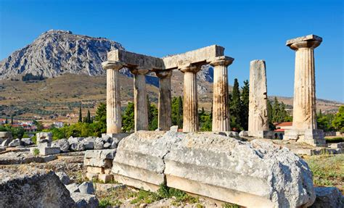
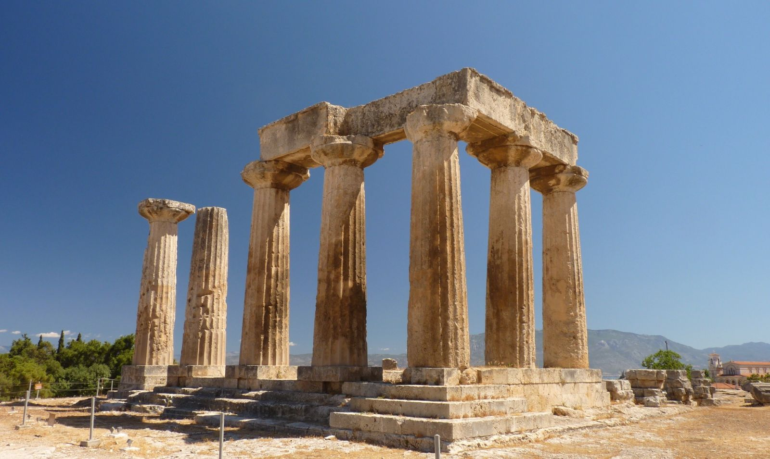
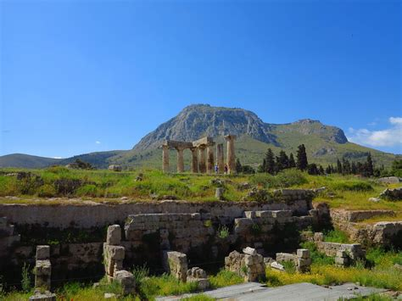
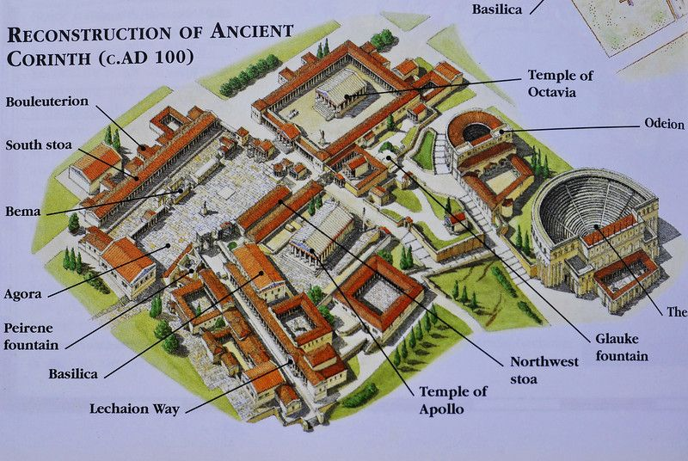
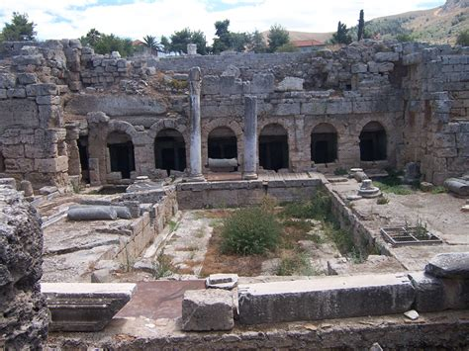
Troubles in Corinth

Slide 7
Troubles in Corinth
Corinth overview:
Peloponnese, ancient Greece
Prosperous Greco-Roman colony / city-state
Important meeting place of N, S, E, W, over land and sea
Greeks, Romans, Jews, slaves and free, temples and trade
Social environment was having a negative influence on the practises of the local church

Slide 8
Troubles in Corinth
Chain of events leading to the letter:
Paul visits the city in 49 - 50 AD (meets Aquila and Priscilla)
Corinthian church planted, circa 52 AD (Acts 18:1-11)
Paul leaves for missionary work in Ephesus (Apollos met)
Apollos visits Archaia (Corinth), leaves and meets Paul
Paul’s lost first letter to the Corinthians (letter A)
Corinthian reply letter to Paul, and oral reports (1Cor 1:11)
1 Corinthians written circa 54 - 56 AD and sent w. Timothy

Slide 9
Troubles in Corinth
In chapter one we looked at Paul’s introduction and how he identifies the root cause of the church’s problems.
Be mindful to be thankful of your salvation
Be mindful of man-centred faith
Be mindful of missing the power of the cross
Be mindful of boasting about the wrong things

Slide 10
Troubles in Corinth
1 Corinthians Chapters 1 - 4 help us to:
Understand the true nature of the church’s conflicts
Identify the ‘common ground’ items in the church:
  Christ crucified (cross) is God’s power and wisdom
  God’s wisdom revealed through the Holy Spirit
  The church and its leaders are in service to God
  The nature of true apostleship

Slide 11
Troubles in Corinth
1 Corinthians 1:26 - 2:5
Greek rhetorical speech - academic art of persuasion
  Sam Leith - You talkin’ to me? e.g. “build, back, better”
Influential Jewish, Alexandrian speaker, Apollos, likely (but inadvertently) caused division when he visited
Paul didn’t use rhetorical devices to preach the gospel
God’s wisdom revealed through the Holy Spirit is sufficient for its purpose to bring about salvation

Slide 12
Troubles in Corinth
1 Corinthians 2:6 - 16
God’s wisdom was hidden before Christ was revealed
There is an eternal, spiritual nature to reality
Spiritual understanding comes from God
Misunderstanding the work of the Holy Spirit can lead to confusion and division in an immature church
The Spirit is a deposit for our salvation and Holiness

Slide 13
Troubles in Corinth
In summary - the church in Corinth is a blessing in disguise for us as it helps to:
Understand the true nature of conflict in a church
Focus our attention on the unifying items of our faith
Remember the spiritual, eternal reality that is at work within the people of God

